Slide 1


Essex Faith Covenant – social prescribing

Slide 2
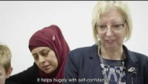
BACKGRROUND

Slide 3
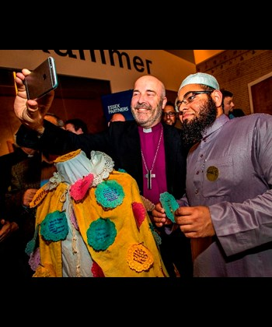
BACKGRROUND
Both faith groups and public services will commit to working together to:
Pro-actively build relationships and trust between faith groups and public services
Create opportunities to raise awareness and share learning and knowledge between different faith communities, and within the public services
Seek opportunities to bring people together to serve the community, particularly the most disadvantaged

Slide 4

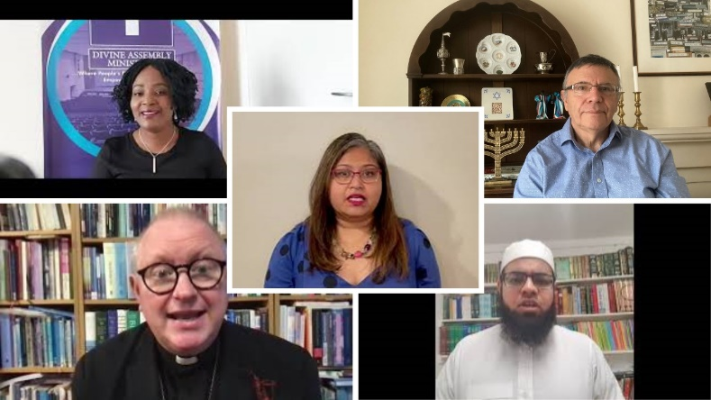
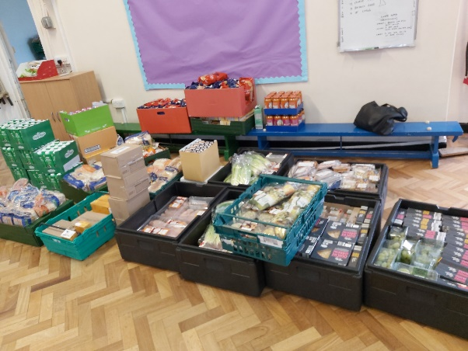
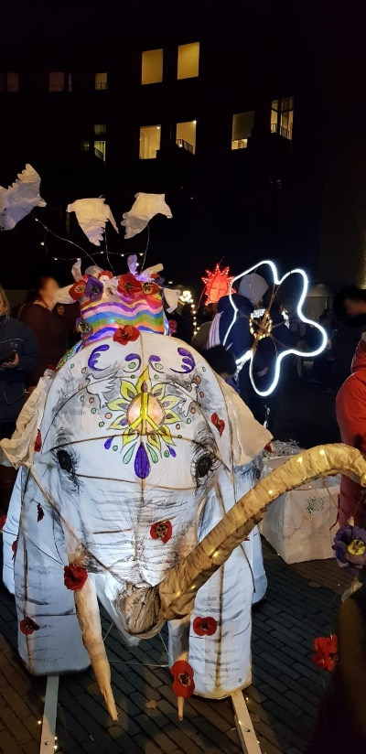
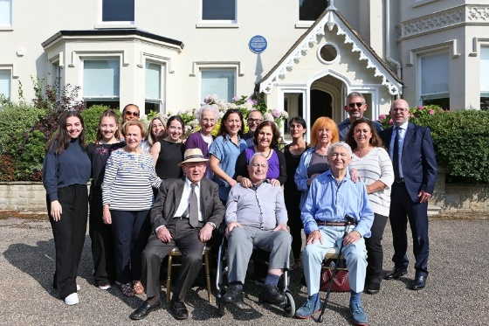
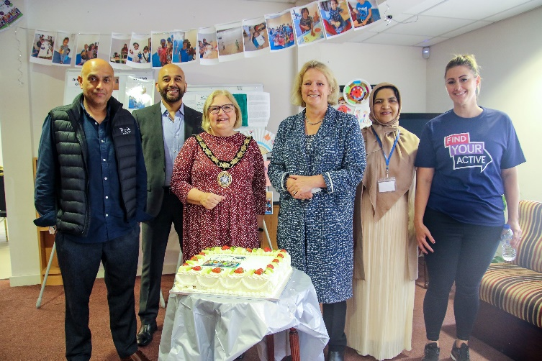
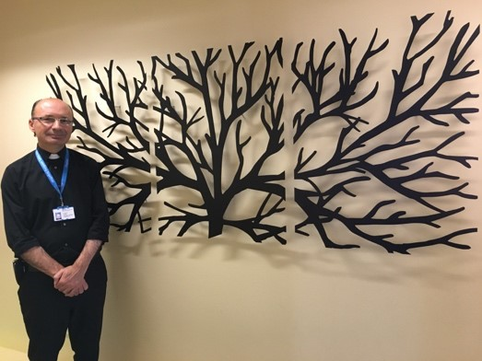
Essex Faith Covenant in action

Slide 5

Background – social prescribing
In early 2020, Faith Action published a report looking into the relationship between faith-based organisations and social prescribing schemes, which included recommendations on how to make them stronger
According to the NHS, good social prescribing will ensure that “services are fully accessible to all communities, including those in greatest need, who may be hardest for agencies to reach.
Achieving this will mean taking stock of the full range of local faith-based service provision, since we know that many communities are beyond the “reach” of services, and facing the starkest health inequalities, will remain an active part of a local faith group

Slide 6
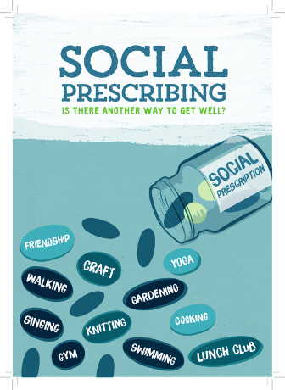
FB0s and social prescribing
What specific attributes do FBOs have:
Clear links between faith and wellbeing
A significant sector within our communities
Active in all communities
Assets
Offers that complement public services

Slide 7
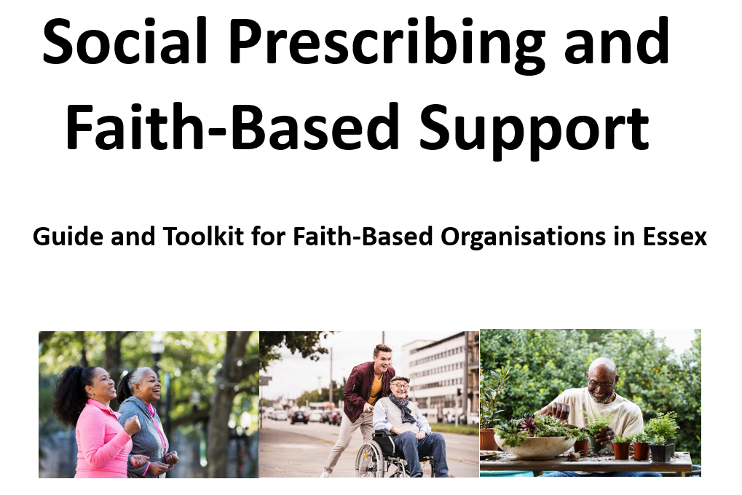
What has been delivered
Using asset mapping project from Community360 to understand the faith-based provision in the area. Identify any blind spots in mapping exercise. Where appropriate, reflect provision in social prescribing database.
Awareness raising training session delivered for faith groups
Resource developed for social prescribers to better understand how to engage with clients with a faith to enable more meaningful interventions.
Develop case studies highlighting good practice i.e. faith-based organisations successfully engaging in social prescribing outlining their experience.
Development of a multi-faith engagement toolkit to help faith-based organisations review their health assets and better articulate exactly how they can support social prescribing schemes and the health and wellbeing of their local community.

Slide 8
What has been delivered
Contact:
Faithcovenant@essex.gov.uk

